Slide 1
Introducing CheckBoxes
and
Message Dialogs

Slide 2
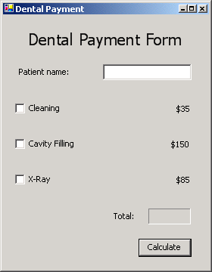
CheckBox control
Small white square, 2 states
Blank
Containing a check mark
CheckBox controls (unchecked)

Slide 3
CheckBox control
Adding highlighted code
Initializes Text property and sets variables
Uses If…Then statements
CheckBox’s property Checked
Increments total variable
Format output as currency

Slide 4
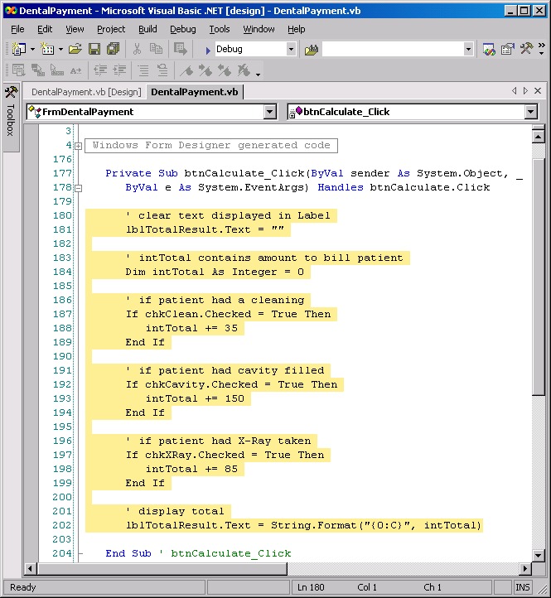
CheckBox control
Using the Checked property.
Add this highlighted code
Notes:
Public Class Form1
Private Sub Label7_Click(ByVal sender As System.Object, ByVal e As System.EventArgs) Handles Label7.Click
End Sub
Private Sub Button1_Click(ByVal sender As System.Object, ByVal e As System.EventArgs) Handles Button1.Click
Label7.Text = ""
Dim total As Integer
If CheckBox1.Checked = True Then
total += 35
End If
If CheckBox2.Checked = True Then
total += 150
End If
If CheckBox3.Checked = True Then
End If
If CheckBox3.Checked = True Then
total += 85
End If
Label7.Text = String.Format("{0:c}", total) ‘{0} AED
End Sub
End Class

Slide 5
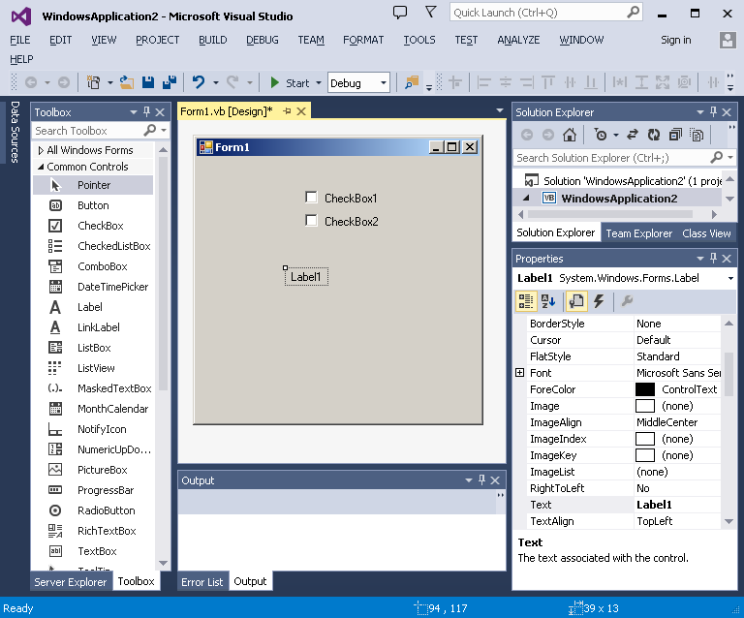

Slide 6
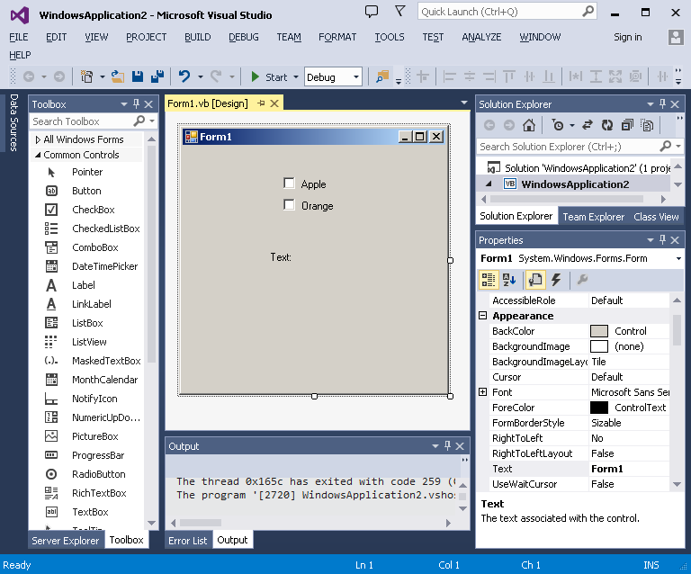

Slide 7
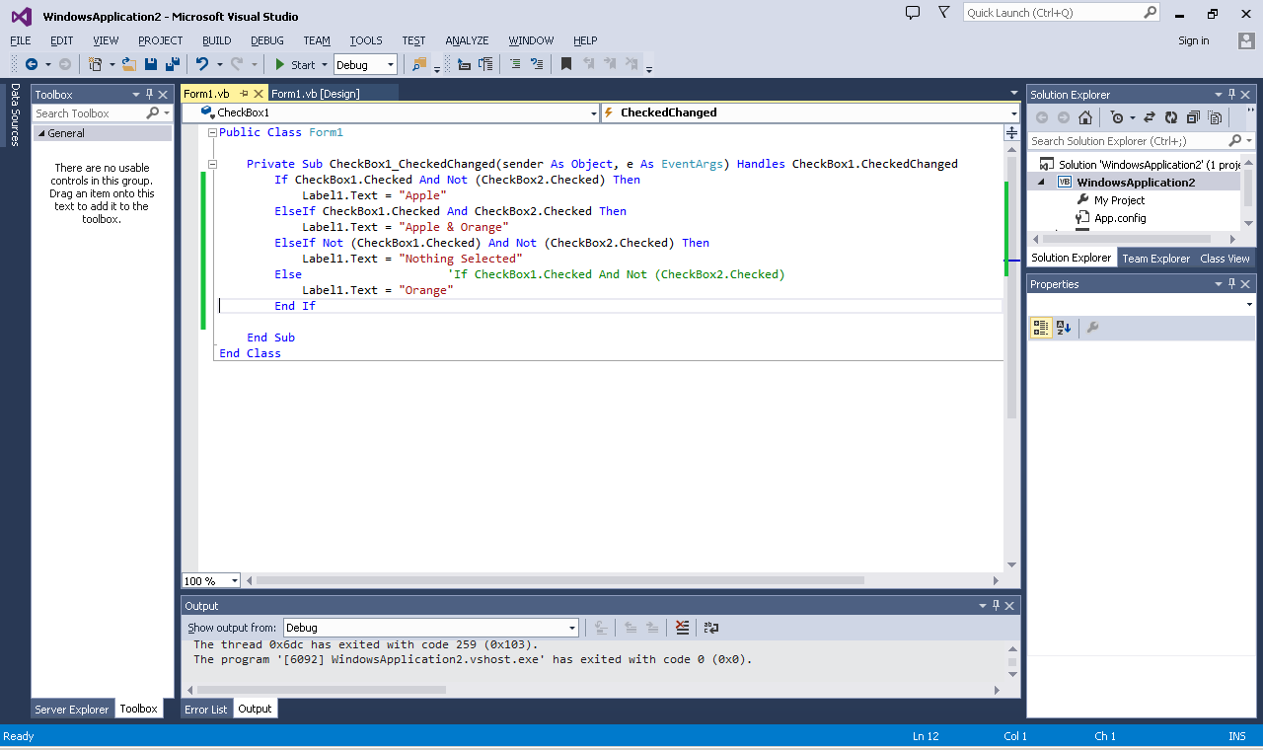
Notes:
Elseif rather than if only
If CheckBox1.Checked And Not CheckBox2.Checked Then
Label1.Text = "orrange"
End If
If CheckBox1.Checked And CheckBox2.Checked Then
Label1.Text = "apple and orange"
End If
If Not CheckBox1.Checked And Not CheckBox2.Checked Then
Label1.Text = "nothing"
End If
If Not CheckBox1.Checked And CheckBox2.Checked Then
Label1.Text = "apple"
End If

Slide 8
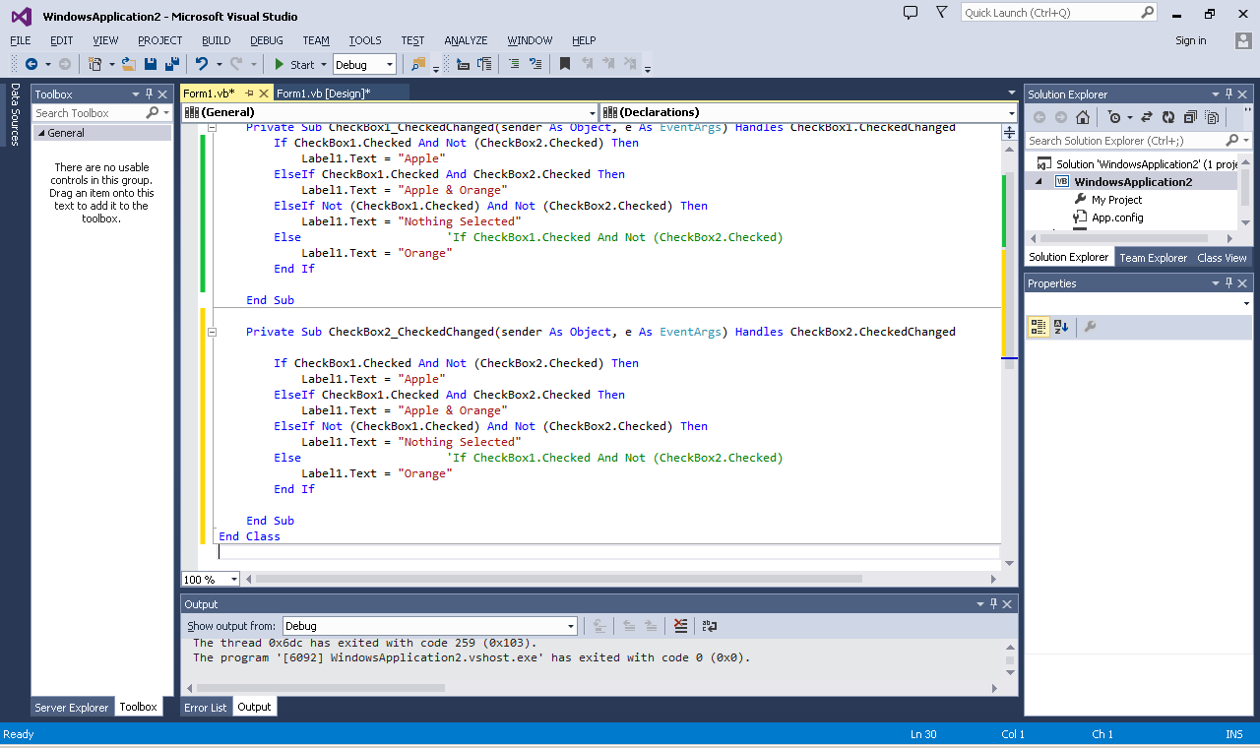
Notes:
Public Class Form1
Private Sub CheckBox1_CheckedChanged(ByVal sender As System.Object, ByVal e As System.EventArgs) Handles CheckBox1.CheckedChanged
If CheckBox1.Checked And Not CheckBox2.Checked Then
Label3.Text = "Apple"
ElseIf CheckBox1.Checked And CheckBox2.Checked Then
Label3.Text = "Apple & Orange"
ElseIf Not CheckBox1.Checked And Not CheckBox2.Checked Then
Label3.Text = "Nothing Selected"
Else
Label3.Text = "Orange"
End If
End Sub
Private Sub CheckBox2_CheckedChanged(ByVal sender As System.Object, ByVal e As System.EventArgs) Handles CheckBox2.CheckedChanged
If CheckBox1.Checked And Not CheckBox2.Checked Then
Label3.Text = "Apple"
ElseIf CheckBox1.Checked And CheckBox2.Checked Then
Label3.Text = "Apple && Orange"
ElseIf Not CheckBox1.Checked And Not CheckBox2.Checked Then
Label3.Text = "Nothing Selected"
Else
Label3.Text = "Orange"
End If
End Sub
End Class

Slide 9
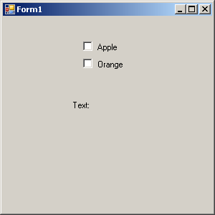
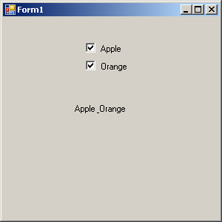

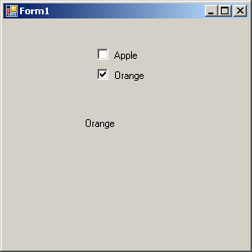
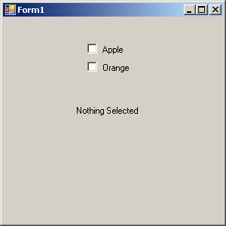
Initial Window =>
Label1.text is set to “Text”

Slide 10
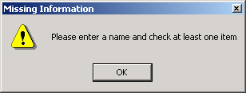
Message dialog appears when no name is entered and/or no CheckBoxes are selected.
Title bar
Close box
Icon indicates the tone of the message
OK Button allows the user to close the dialog
Dialog sized to accommodate contents
Missing Information dialog
No name entered
No CheckBoxes selected

Slide 11
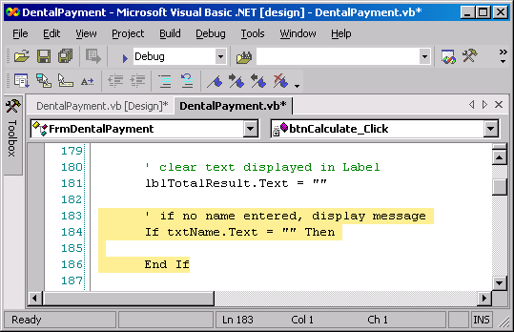
Using a Dialog to Display a Message
Adding an If…Then to the btnCalculate_Click event handler to display a message dialog.
Add this highlighted code

Slide 12
Using a Dialog to Display a Message
Message dialog
MessageBox.Show method
Four arguments
Specifying text in the dialog
Specifying text in the title bar
Indicating which button(s) to display at the bottom of the dialog
Indicating which icon appears at the left of the dialog

Slide 13
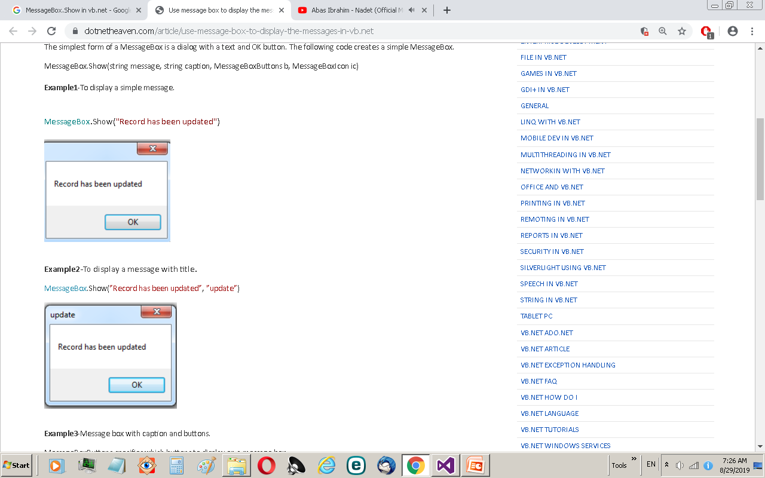
Notes:
https://www.dotnetheaven.com/article/use-message-box-to-display-the-messages-in-vb.net

Slide 14
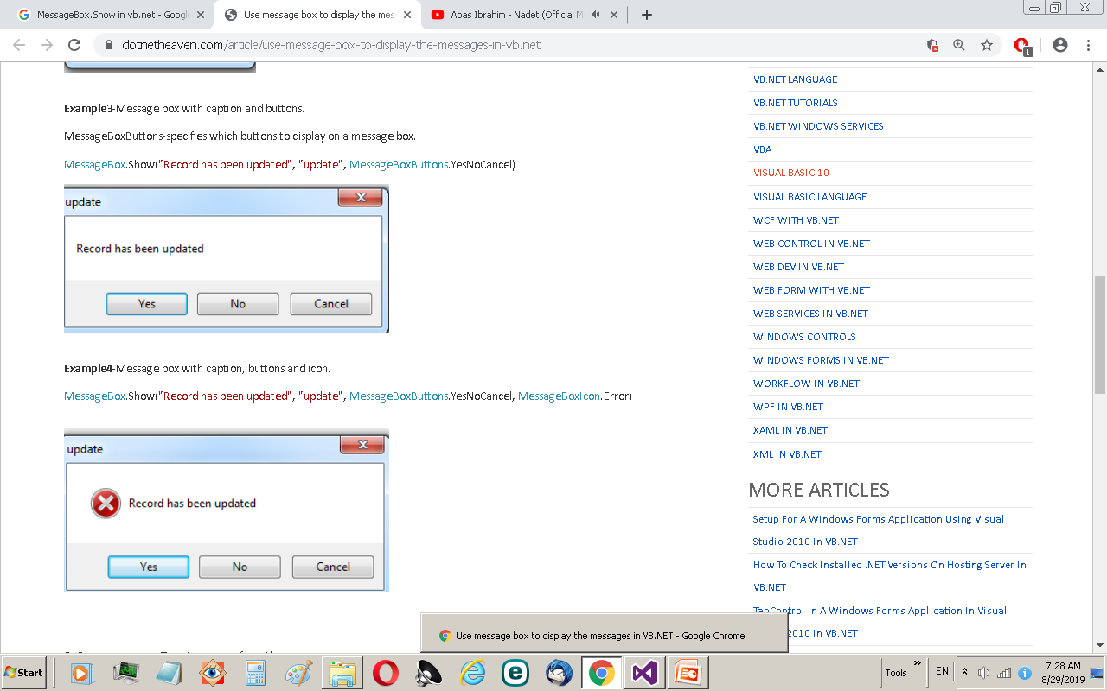
Notes:
https://www.dotnetheaven.com/article/use-message-box-to-display-the-messages-in-vb.net

Slide 15

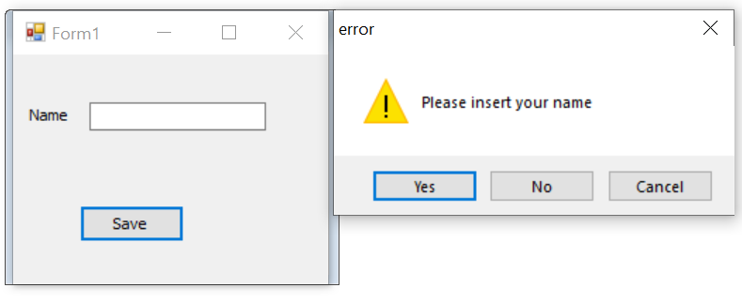

Slide 16
Public Class Form1
Private Sub Button1_Click(sender As Object, e As EventArgs) Handles Button1.Click
If TextBox1.Text = "" Then
Dim aaa As DialogResult = MessageBox.Show("kindly insert name", "Missing", MessageBoxButtons.YesNoCancel, MessageBoxIcon.Information)
If aaa = DialogResult.Yes Then
MessageBox.Show("yes clicked")
ElseIf aaa = DialogResult.No Then
MessageBox.Show("No clicked")
Else
MessageBox.Show("cancel clicked")
End If
End If
End Sub
End Class
Notes:
Public Class Form1
Private Sub Form1_Load(ByVal sender As System.Object, ByVal e As System.EventArgs) Handles MyBase.Load
End Sub
Private Sub Button1_Click(ByVal sender As System.Object, ByVal e As System.EventArgs) Handles Button1.Click
If TextBox1.Text = "" Then
Dim ans As DialogResult = MessageBox.Show("Please insert your name", "Missing", MessageBoxButtons.YesNoCancel, MessageBoxIcon.Warning)
If ans = DialogResult.Yes Then
MessageBox.Show("Yes clicked", "yes")
ElseIf ans = DialogResult.No Then
MessageBox.Show("No clicked")
Else
MessageBox.Show("Cancel clicked")
End If
End If
If CheckBox1.Checked = False Then
MessageBox.Show("empty")
End If
End Sub
End Class

